Slide 1

GeoHealth: Revolutionizing Healthcare Accessibility
In today's fast-paced world, access to quality healthcare is paramount. Yet, navigating the healthcare system can be a daunting task, especially in emergencies or when seeking specialized care. GeoHealth emerges as a revolutionary solution, leveraging advanced data structures and algorithms to empower users with seamless and efficient healthcare navigation.

Slide 2
Introduction to the GeoHealth Project
GeoHealth is a comprehensive platform designed to enhance healthcare accessibility and empower individuals with the information they need to make informed decisions about their health. The project leverages a powerful suite of data structures, including R-trees, heaps, tries, and stacks, to optimize key functionalities, ensuring rapid and accurate results.
Efficient Hospital Search
Top-Rated Hospital Discovery
Comprehensive Hospital Information
The platform enables users to quickly find the nearest hospital based on their current location or a specific address, using an R-tree to efficiently store and retrieve hospital data.
GeoHealth leverages a heap data structure to dynamically rank hospitals based on user reviews, reputation, and other relevant criteria, allowing users to discover the best-rated hospitals in their area.
GeoHealth provides users with detailed information about each hospital, including contact details, specialty services, availability, and user reviews, empowering them to make informed choices.

Slide 3

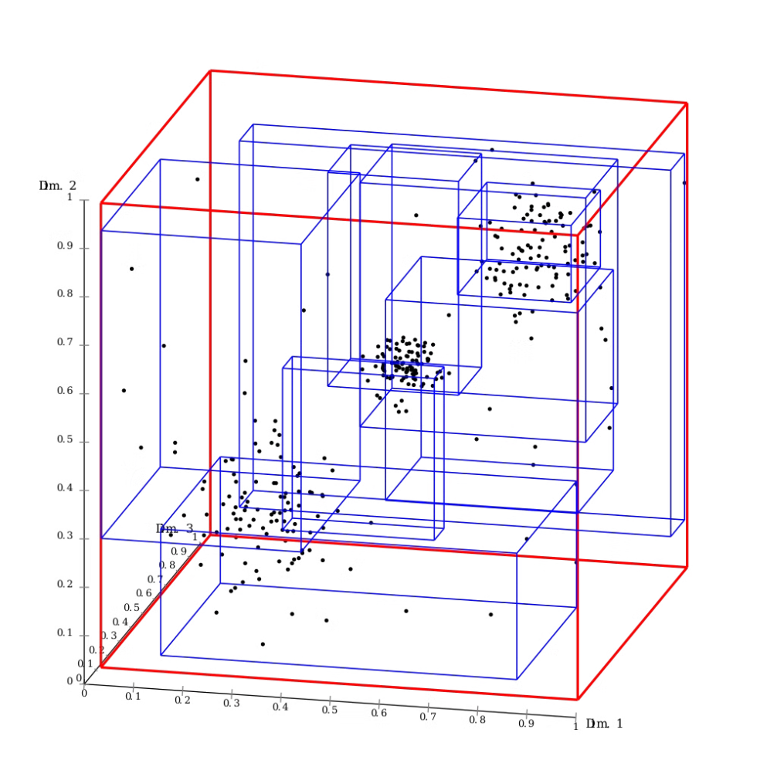
Leveraging R-Trees for Nearest Hospital Search
At the heart of GeoHealth's search functionality lies the R-tree data structure. This spatial indexing technique efficiently stores and retrieves geographic data, making it ideal for finding the nearest hospital based on a user's location. R-trees organize spatial data into a hierarchical tree structure, where each node represents a region of space, and its children represent smaller regions within it.
When a user requests a nearest hospital search, GeoHealth uses the R-tree's hierarchical structure to quickly narrow down the search space. It traverses the tree, starting at the root node and descending to child nodes that contain the user's location, efficiently eliminating regions of space that do not contain potential hospitals. This process significantly reduces the number of hospital records that need to be examined, resulting in significantly faster search times.

Slide 4


Maximizing Hospital Rankings with Heaps
To enable users to discover the highest-rated hospitals in their area, GeoHealth employs a max-heap data structure. A heap is a binary tree-based data structure where each node's value is greater than or equal to its children. In the context of GeoHealth, the heap stores hospital ratings, with the highest-rated hospital residing at the root node.
The max-heap allows for efficient retrieval of the top-rated hospitals. Since the highest-rated hospital is at the root, it can be accessed directly. Moreover, the heap's property of maintaining the order of ratings allows for efficient updates as new reviews or ratings are added, ensuring that the rankings are always accurate and up-to-date.

Slide 5

Efficient Hospital and City Search with Tries
GeoHealth utilizes a trie data structure to facilitate efficient search by hospital name or city. A trie, also known as a prefix tree, is a tree-based data structure that stores strings efficiently by sharing common prefixes. In the context of GeoHealth, the trie stores both hospital names and city names.
When a user enters a search query, GeoHealth traverses the trie, following branches that correspond to the characters in the query. This approach allows for rapid identification of matching hospitals or cities, even if the user has only entered a partial name or city. The trie's prefix-based organization ensures that only relevant data is accessed, reducing search time significantly.

Slide 6

Tracking Search History with Stacks
To provide users with a personalized experience and facilitate easy access to previously searched hospitals or cities, GeoHealth utilizes a stack data structure to track search history. A stack is a linear data structure that follows a last-in, first-out (LIFO) principle, where the most recent element is at the top of the stack. In GeoHealth, each search query is added to the stack as the user performs a search.
When a user wants to revisit a previous search, they can access the stack's history. The stack's LIFO behavior allows for easy retrieval of recently searched items. Users can easily access and review their previous searches, providing them with a convenient and personalized experience.

Slide 7
Comparison to Alternative Data Structures
While other data structures like graphs, trees, and arrays could be used for specific tasks within GeoHealth, our choice of R-trees, heaps, tries, and stacks offers a more efficient and optimized approach. For instance, graphs, while good for representing relationships, are less efficient for spatial indexing compared to R-trees. Trees, while useful for hierarchical data, lack the spatial indexing capability of R-trees.
Data Structure
Strengths
Weaknesses
R-tree
Efficient spatial indexing for nearest neighbor search
Can become less efficient for very high-dimensional data
Heap
Efficient retrieval of top-ranked elements, efficient updates
Not suitable for complex search patterns
Trie
Efficient prefix-based search, space-efficient for storing strings
Can be less efficient for large datasets with long strings
Stack
Efficient last-in-first-out retrieval, easy to implement
Limited to linear access, not suitable for complex search patterns

Slide 8
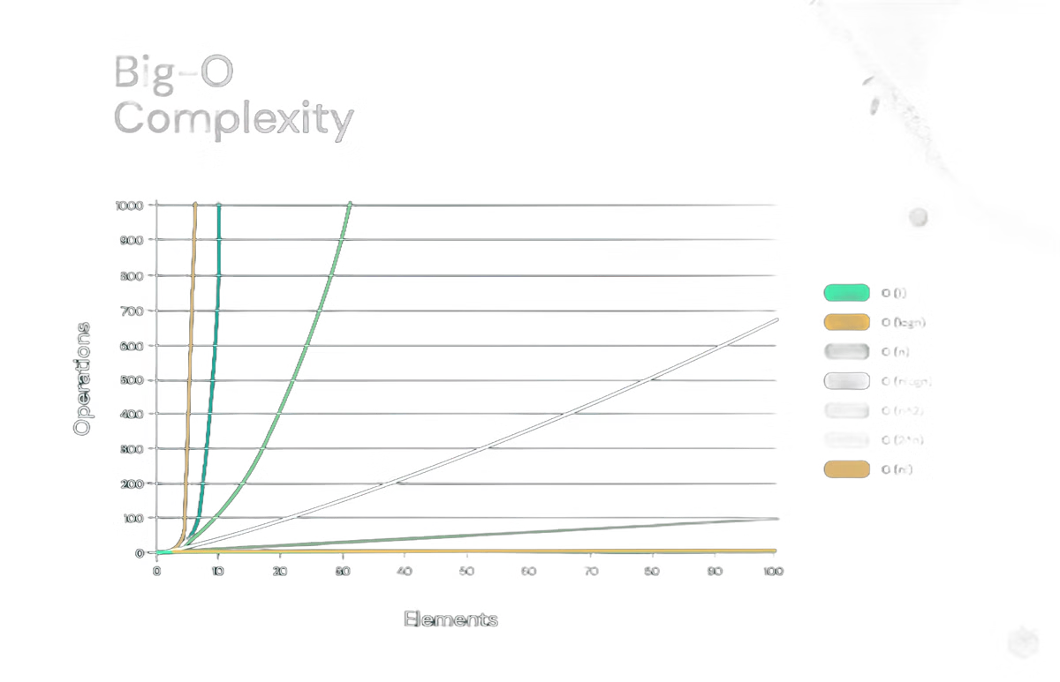
Efficiency Advantages of Our Approach
By utilizing R-trees, heaps, tries, and stacks, GeoHealth achieves significant efficiency gains over alternative data structures. The spatial indexing of R-trees allows for rapid nearest neighbor search, while the heap's efficient retrieval of top-ranked elements empowers users to discover the best-rated hospitals. Tries offer rapid prefix-based search, enabling users to efficiently find hospitals or cities based on partial input. The stack's LIFO behavior provides easy access to recent search history, enhancing user experience.
These optimized data structures translate into faster search times, reduced resource usage, and a smoother user experience, making GeoHealth a highly efficient and effective healthcare navigation platform.

Slide 9

Real-World Applications of GeoHealth
GeoHealth's impact extends far beyond simply providing directions to nearby hospitals. Its potential applications are vast and can significantly enhance healthcare accessibility and emergency response in various real-world scenarios.
1
Emergency Response
2
Healthcare Navigation for Tourists
In emergency situations, GeoHealth can be instrumental in guiding emergency responders to the nearest available hospital, reducing response times and potentially saving lives.
Tourists visiting new cities can leverage GeoHealth to quickly find the nearest hospitals in case of medical emergencies or when seeking healthcare services.
3
Personalized Healthcare Recommendations
GeoHealth can be integrated with wearable health devices to provide personalized healthcare recommendations, suggesting nearby hospitals or clinics based on individual health data and preferences.

Slide 10

Conclusion and Future Developments
GeoHealth is a testament to the power of data structures and algorithms in addressing real-world challenges. By leveraging R-trees, heaps, tries, and stacks, GeoHealth provides a robust and efficient solution for healthcare navigation, empowering users with accurate and timely information. The platform's potential applications extend far beyond its core functionality, promising to revolutionize the way we access and navigate healthcare.
As GeoHealth continues to evolve, we envision a future where it seamlessly integrates with wearable health devices, telemedicine platforms, and other healthcare services, creating a comprehensive and personalized healthcare experience. We aim to continuously refine and enhance GeoHealth, ensuring that it remains at the forefront of healthcare accessibility and innovation.

